Slide 1
안드로이드 실무 5주차 과제
1901055 정시철

Slide 2
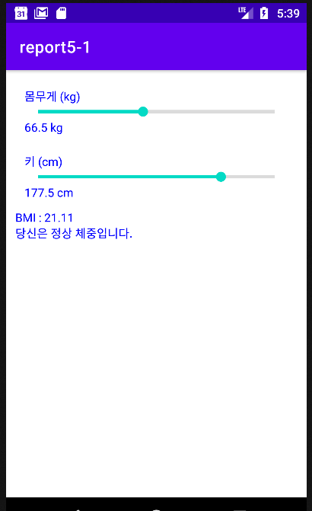
Report 1 BMI계산기
<?xml version="1.0" encoding="utf-8"?> <LinearLayout xmlns:android="http://schemas.android.com/apk/res/android" xmlns:app="http://schemas.android.com/apk/res-auto" xmlns:tools="http://schemas.android.com/tools" android:layout_width="match_parent" android:layout_height="match_parent" android:orientation="vertical" android:padding="5pt" tools:context=".MainActivity"> <LinearLayout android:orientation="vertical" android:layout_width="match_parent" android:layout_height="wrap_content" android:layout_margin="5pt"> <TextView android:textColor="#0000ff" android:layout_width="wrap_content" android:layout_height="wrap_content" android:text="몸무게 (kg)"/> <SeekBar style="@style/Widget.AppCompat.ProgressBar.Horizontal" android:id="@+id/sb1" android:layout_width="match_parent" android:layout_height="wrap_content" android:max="230"/> <TextView android:textColor="#0000ff" android:layout_width="wrap_content" android:layout_height="wrap_content" android:id="@+id/result1" android:text="35.0 kg"/> </LinearLayout> <LinearLayout android:orientation="vertical" android:layout_width="match_parent" android:layout_height="wrap_content" android:layout_margin="5pt"> <TextView android:textColor="#0000ff" android:layout_width="wrap_content" android:layout_height="wrap_content" android:text="키 (cm)"/> <SeekBar style="@style/Widget.AppCompat.ProgressBar.Horizontal" android:id="@+id/sb2" android:layout_width="match_parent" android:layout_height="wrap_content" android:max="280"/> <TextView android:textColor="#0000ff" android:layout_width="wrap_content" android:layout_height="wrap_content" android:id="@+id/result2" android:text="90.0 cm"/> </LinearLayout> <TextView android:textColor="#0000ff" android:layout_width="wrap_content" android:layout_height="wrap_content" android:id="@+id/result3"/> <TextView android:textColor="#0000ff" android:layout_width="wrap_content" android:layout_height="wrap_content" android:id="@+id/result4"/> </LinearLayout>
package com.example.report5_1; import androidx.appcompat.app.AppCompatActivity; import android.os.Bundle; import android.widget.SeekBar; import android.widget.TextView; public class MainActivity extends AppCompatActivity { float cm = 70, kg = 180; TextView result3; TextView result4; @Override protected void onCreate(Bundle savedInstanceState) { super.onCreate(savedInstanceState); setContentView(R.layout.activity_main); SeekBar sb1 = findViewById(R.id.sb1); SeekBar sb2 = findViewById(R.id.sb2); TextView result1 = findViewById(R.id.result1); TextView result2 = findViewById(R.id.result2); result3 = findViewById(R.id.result3); result4 = findViewById(R.id.result4); sb1.setOnSeekBarChangeListener(new SeekBar.OnSeekBarChangeListener() { @Override public void onProgressChanged(SeekBar seekBar, int i, boolean b) { kg = (float) (i +70)/ 2; result1.setText(String.format("%.1f kg",kg)); bmi(kg,cm); } @Override public void onStartTrackingTouch(SeekBar seekBar) { } @Override public void onStopTrackingTouch(SeekBar seekBar) { }}); sb2.setOnSeekBarChangeListener(new SeekBar.OnSeekBarChangeListener() { @Override public void onProgressChanged(SeekBar seekBar, int i, boolean b) { cm = (float) (i+180) / 2; result2.setText(String.format("%.1f cm",cm)); bmi(kg,cm); } @Override public void onStartTrackingTouch(SeekBar seekBar) { } @Override public void onStopTrackingTouch(SeekBar seekBar) { }}); } public void bmi(float kg,float cm){ float r = kg/((cm/100)*(cm/100)); result3.setText(String.format("BMI : %.2f",r)); if (r<18.5) result4.setText("당신은 저체중입니다."); else if (r>23.0) result4.setText("당신은 과체중입니다."); else result4.setText("당신은 정상 체중입니다."); } }

Slide 3
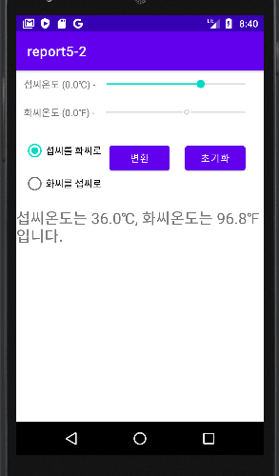
Report 2 온도계
<?xml version="1.0" encoding="utf-8"?> <LinearLayout xmlns:android="http://schemas.android.com/apk/res/android" xmlns:app="http://schemas.android.com/apk/res-auto" xmlns:tools="http://schemas.android.com/tools" android:layout_width="match_parent" android:layout_height="match_parent" android:orientation="vertical" tools:context=".MainActivity"> <LinearLayout android:layout_margin="5pt" android:layout_width="match_parent" android:layout_height="wrap_content"> <TextView android:layout_width="wrap_content" android:layout_height="wrap_content" android:text="섭씨온도 (0.0℃) -"/> <SeekBar android:layout_width="match_parent" android:layout_height="wrap_content" android:id="@+id/sb1" android:progress="100" android:max="200"/> </LinearLayout> <LinearLayout android:layout_margin="5pt" android:layout_width="match_parent" android:layout_height="wrap_content"> <TextView android:layout_width="wrap_content" android:layout_height="wrap_content" android:text="화씨온도 (0.0℉) -"/> <SeekBar android:layout_width="match_parent" android:layout_height="wrap_content" android:id="@+id/sb2" android:progress="100" android:max="200"/> </LinearLayout> <LinearLayout android:layout_margin="5pt" android:layout_width="match_parent" android:layout_height="wrap_content"> <RadioGroup android:id="@+id/radioGroup" android:orientation="vertical" android:layout_width="wrap_content" android:layout_height="wrap_content"> <RadioButton android:id="@+id/radio1" android:layout_width="wrap_content" android:layout_height="wrap_content" android:text="섭씨를 화씨로"/> <RadioButton android:id="@+id/radio2" android:layout_width="wrap_content" android:layout_height="wrap_content" android:text="화씨를 섭씨로"/> </RadioGroup> <Button android:layout_margin="5pt" android:layout_width="wrap_content" android:layout_height="wrap_content" android:text="변환" android:id="@+id/button1"/> <Button android:layout_margin="5pt" android:layout_width="wrap_content" android:layout_height="wrap_content" android:id="@+id/button2" android:text="초기화"/> </LinearLayout> <TextView android:id="@+id/text" android:textSize="10pt" android:layout_width="wrap_content" android:layout_height="wrap_content"/> </LinearLayout>
package com.example.report5_2; import androidx.appcompat.app.AppCompatActivity; import android.os.Bundle; import android.view.View; import android.widget.Button; import android.widget.RadioButton; import android.widget.RadioGroup; import android.widget.SeekBar; import android.widget.TextView; public class MainActivity extends AppCompatActivity { boolean check; float result,c, f; @Override protected void onCreate(Bundle savedInstanceState) { super.onCreate(savedInstanceState); setContentView(R.layout.activity_main); SeekBar sb1 = findViewById(R.id.sb1); SeekBar sb2 = findViewById(R.id.sb2); TextView text = findViewById(R.id.text); Button button1 = findViewById(R.id.button1); Button button2 = findViewById(R.id.button2); RadioGroup radioGroup = findViewById(R.id.radioGroup); sb1.setOnSeekBarChangeListener(new SeekBar.OnSeekBarChangeListener() { @Override public void onProgressChanged(SeekBar seekBar, int i, boolean b) { c = (float)i-100; } @Override public void onStartTrackingTouch(SeekBar seekBar) { } @Override public void onStopTrackingTouch(SeekBar seekBar) { }}); sb2.setOnSeekBarChangeListener(new SeekBar.OnSeekBarChangeListener() { @Override public void onProgressChanged(SeekBar seekBar, int i, boolean b) { f = (float)i-100; } @Override public void onStartTrackingTouch(SeekBar seekBar) { } @Override public void onStopTrackingTouch(SeekBar seekBar) { }}); radioGroup.setOnCheckedChangeListener(new RadioGroup.OnCheckedChangeListener() { @Override public void onCheckedChanged(RadioGroup radioGroup, int i) { switch (i){ case R.id.radio1: sb1.setEnabled(true); sb2.setEnabled(false); check = true; break; case R.id.radio2: sb2.setEnabled(true); sb1.setEnabled(false); check = false; } }}); button1.setOnClickListener(new View.OnClickListener() { @Override public void onClick(View view) { if (check){ result = (float) ((float)c * 1.8 +32); text.setText(String.format("섭씨온도는 %.1f℃, 화씨온도는 %.1f℉ 입니다.",c,result)); } else { result = (float) ((float) (f-32) / 1.8); text.setText(String.format("화씨온도는 %.1f℉, 섭씨온도는 %.1f℃ 입니다.",f,result)); } }}); button2.setOnClickListener(new View.OnClickListener() { @Override public void onClick(View view) { sb1.setProgress(100); sb2.setProgress(100); }}); } }

Slide 4
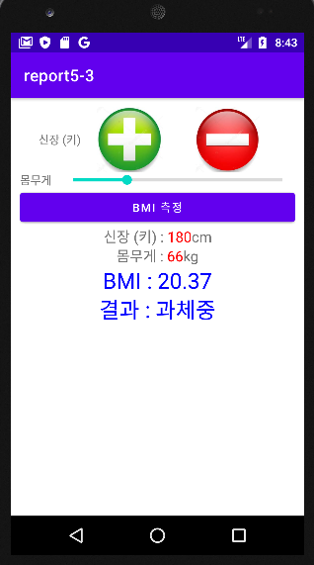
Report 3 BMI 계산기 (버튼형)
package com.example.report5_3; import androidx.appcompat.app.AppCompatActivity; import android.graphics.Color; import android.os.Bundle; import android.text.Spannable; import android.text.SpannableString; import android.text.style.ForegroundColorSpan; import android.view.View; import android.widget.Button; import android.widget.ImageView; import android.widget.SeekBar; import android.widget.TextView; import android.widget.Toast; import org.w3c.dom.Text; public class MainActivity extends AppCompatActivity { int kg = 40,cm = 120; TextView text1,text2; TextView result1,result2; @Override protected void onCreate(Bundle savedInstanceState) { super.onCreate(savedInstanceState); setContentView(R.layout.activity_main); ImageView plus = findViewById(R.id.plus); ImageView minus = findViewById(R.id.minus); text1 = findViewById(R.id.text1); text2 = findViewById(R.id.text2); Button button1 = findViewById(R.id.button1); result1 = findViewById(R.id.result1); result2 = findViewById(R.id.result2); SeekBar sb1 = findViewById(R.id.sb1); plus.setOnClickListener(new View.OnClickListener() { @Override public void onClick(View view) { if (cm>=210){ Toast.makeText(MainActivity.this,"더이상 증가할 수 없습니다.",Toast.LENGTH_SHORT).show(); cm = 210; } else{ ++cm; text1.setText("신장 (키) : "+cm+"cm"); pluscolor(text1,cm); } }}); minus.setOnClickListener(new View.OnClickListener() { @Override public void onClick(View view) { if (cm<=120){ Toast.makeText(MainActivity.this,"더이상 감소할 수 없습니다.",Toast.LENGTH_SHORT).show(); cm = 120; } else{ --cm; text1.setText("신장 (키) : "+cm+"cm"); pluscolor(text1,cm); } }}); sb1.setOnSeekBarChangeListener(new SeekBar.OnSeekBarChangeListener() { @Override public void onProgressChanged(SeekBar seekBar, int i, boolean b) { kg = 40 + i; text2.setText("몸무게 : "+kg+"kg"); pluscolor(text2,kg); } @Override public void onStartTrackingTouch(SeekBar seekBar) { } @Override public void onStopTrackingTouch(SeekBar seekBar) { }}); button1.setOnClickListener(new View.OnClickListener() { @Override public void onClick(View view) { bmi(kg,cm); }}); } public void bmi(float kg,float cm){ float r = kg/ ((cm/100)*(cm/100)); result1.setText(String.format("BMI : %.2f",r)); if (r<18.5) result2.setText("결과 : 저체중"); else if (r>23.0) result2.setText("결과 : 정상 체중"); else result2.setText("결과 : 과체중"); } public void pluscolor(TextView text, int i){ String leng = String.valueOf(i); String content = text.getText().toString(); SpannableString spannableString = new SpannableString(content); int start = content.indexOf(leng); int end = start + leng.length(); spannableString.setSpan(new ForegroundColorSpan(Color.parseColor("#FF0000")), start, end, Spannable.SPAN_EXCLUSIVE_EXCLUSIVE); text.setText(spannableString); } }
<?xml version="1.0" encoding="utf-8"?> <LinearLayout xmlns:android="http://schemas.android.com/apk/res/android" xmlns:app="http://schemas.android.com/apk/res-auto" xmlns:tools="http://schemas.android.com/tools" android:layout_width="match_parent" android:layout_height="match_parent" android:orientation="vertical" android:padding="5pt" tools:context=".MainActivity"> <LinearLayout android:layout_width="match_parent" android:layout_height="wrap_content" android:gravity="center"> <TextView android:layout_width="wrap_content" android:layout_height="wrap_content" android:text="신장 (키)"/> <ImageView android:id="@+id/plus" android:layout_width="120dp" android:layout_height="80dp" android:src="@drawable/plus" /> <ImageView android:id="@+id/minus" android:layout_width="120dp" android:layout_height="80dp" android:src="@drawable/minus" /> </LinearLayout> <LinearLayout android:layout_width="match_parent" android:layout_height="wrap_content" android:gravity="center"> <TextView android:layout_width="wrap_content" android:layout_height="wrap_content" android:text="몸무게 "/> <SeekBar style="@style/Widget.AppCompat.ProgressBar.Horizontal" android:id="@+id/sb1" android:layout_width="match_parent" android:layout_height="wrap_content" android:max="100"/> </LinearLayout> <Button android:id="@+id/button1" android:layout_width="match_parent" android:layout_height="wrap_content" android:text="BMI 측정"/> <TextView android:id="@+id/text1" android:layout_width="match_parent" android:layout_height="wrap_content" android:textSize="8pt" android:text="신장(키) : " android:gravity="center"/> <TextView android:id="@+id/text2" android:layout_width="match_parent" android:layout_height="wrap_content" android:textSize="8pt" android:text="몸무게 : " android:gravity="center"/> <TextView android:textColor="#0000ff" android:id="@+id/result1" android:textSize="12pt" android:layout_width="match_parent" android:layout_height="wrap_content" android:gravity="center"/> <TextView android:textColor="#0000ff" android:id="@+id/result2" android:textSize="12pt" android:layout_width="match_parent" android:layout_height="wrap_content" android:gravity="center"/> </LinearLayout>
딱히 기준을 정해놓은게 없어서
최소 120, 최대 210cm, 몸무게는 40~140kg으로
설정했습니다.

Slide 5
원래 5주차인데 6주차로 오타나신거 같아요. 일단 5주차로 썼습니다. 수정 부탁드립니다.

